Slide 1
Programming JAVA {
Hiveed.java
TypeCasting ;
/* Here is where your journey for your dream begins */
}
JAVA Programming

Slide 2
Hiveed.java
What is TypeCasting :
TypeCasting is the process of converting one non-primitive datatype into another non-primitive datatype.
TYPECASTING
Upcasting
Downcasting
JAVA Programming

Slide 3
Hiveed.java
Upcasting
Upcasting is the typecasting of a child object to a parent object.
Upcasting can be done implicitly.
Upcasting gives us the flexibility to access the parent class members but it is not possible to access all the child class members using this feature.
we can access the overridden methods. Advantage is Generalization of object.
SYNTAX :
Child c = new Child();
Parent p = new Child(): ;
JAVA Programming

Slide 4
Hiveed.java
Example :
ChildClass
ParentClass
non-Private-variables,methods
[ parent-class]
non-Private-variables
non-Private-methods
variables [ Child-class ,]
methods-[ child Class ]
Extends
ChildClass c=new ChildClass();
ParentClass p=new ChildClass();
JAVA Programming

Slide 5
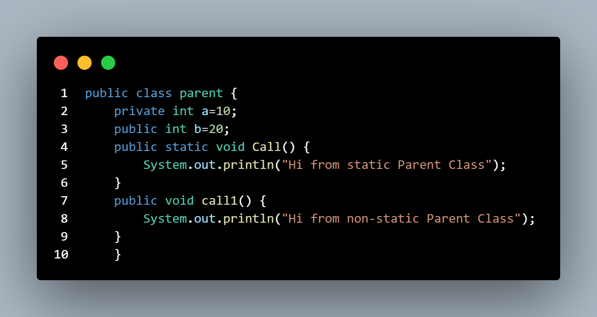
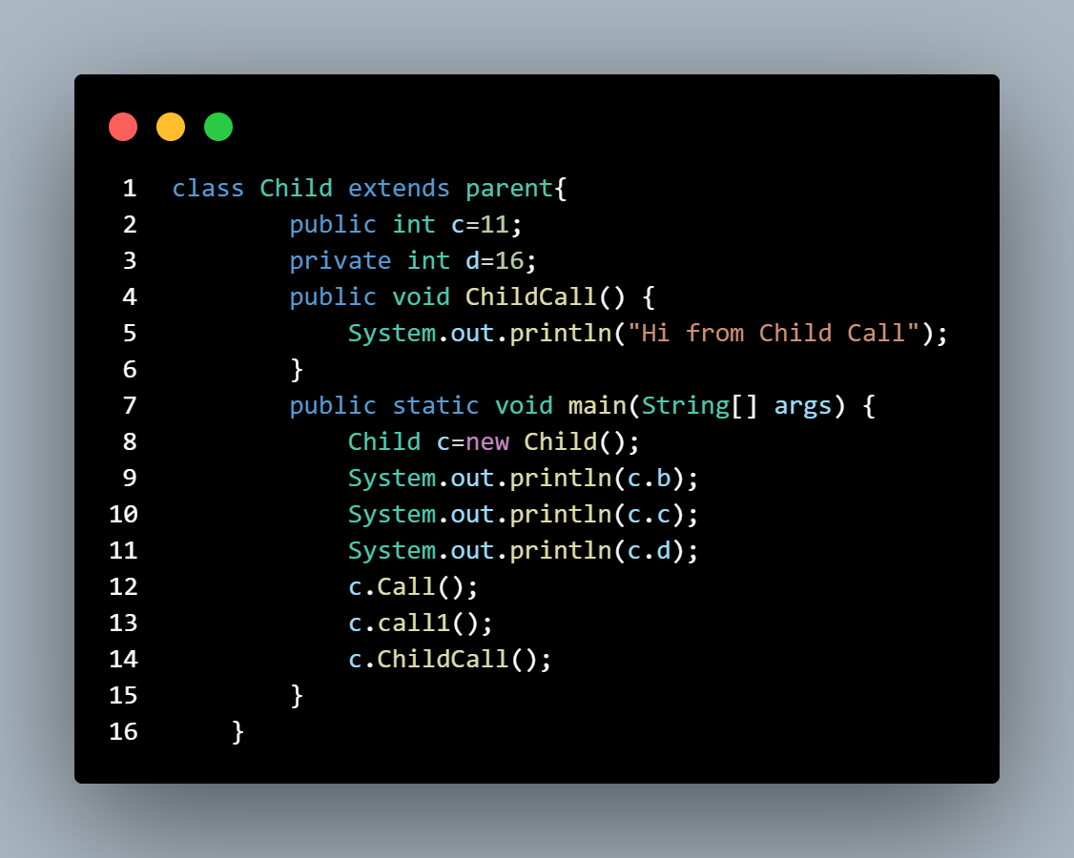
Hiveed.java
JAVA Programming

Slide 6
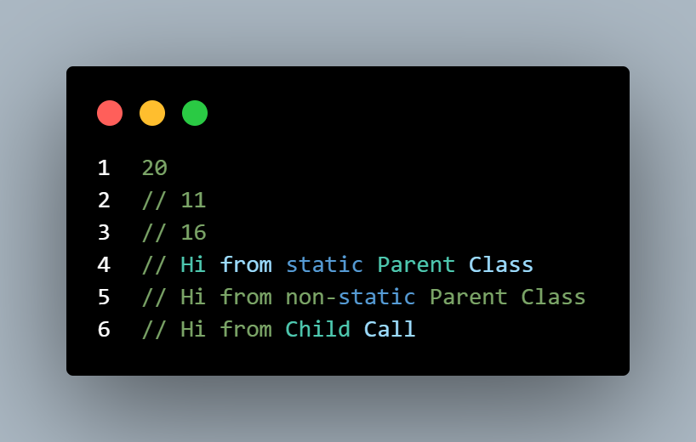
Hiveed.java
OUTPUT :
JAVA Programming

Slide 7
Hiveed.java
Downcasting :
Downcasting is the process of storing parenttype object into the childtype reference type is known the downcasting.
Downcasting done explicitly.
Syntax :
ChildClass c=new ParentClass();
ClassCastException error
JAVA Programming

Slide 8
Hiveed.java
ClassCastException :
ClassCastException is the complie time error inordert to avoid this programmer must to do typecasting it.
Syntax :
Child c=new Child();
Parent p=(Parent)c;
JAVA Programming

Slide 9
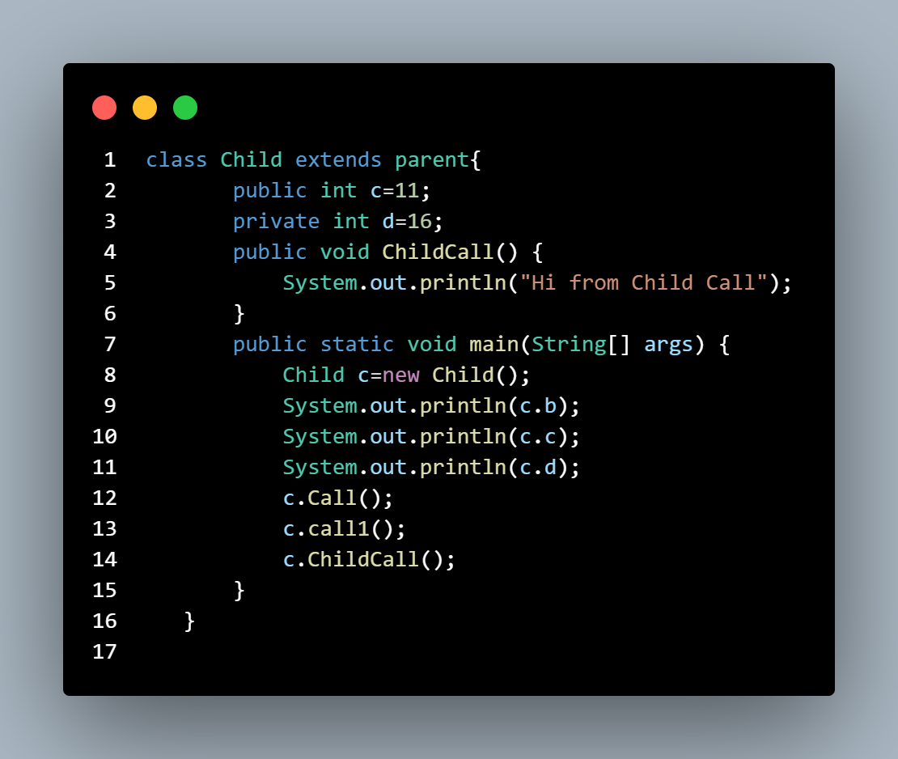
Hiveed.java
JAVA Programming

Slide 10
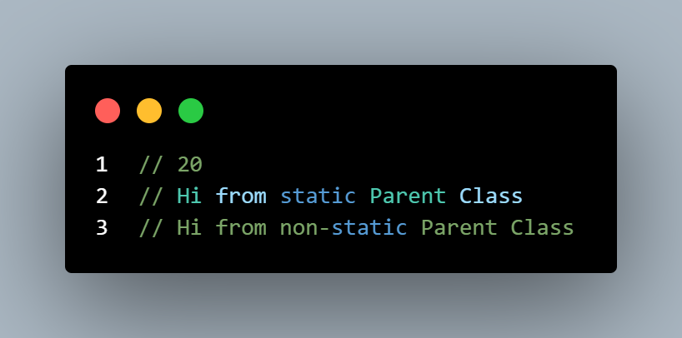
Hiveed.java
Output :
JAVA Programming

Slide 11
Hiveed.java
This Keyword:
‘this’ is a reference variable that refers to the current object, or can be said “this” in Java is a keyword that refers to the current object instance.
When the instance variable and the local variable is same we use “this” keyword to represent the instance variable.
Syntax :
this.a=a
JAVA Programming

Slide 12
Hiveed.java
This call:
This call statement is used to call from one constructor to another constructor.
This call statement is used to reduce the codes.
This call is the first statement in the constructor.
JAVA Programming

Slide 13
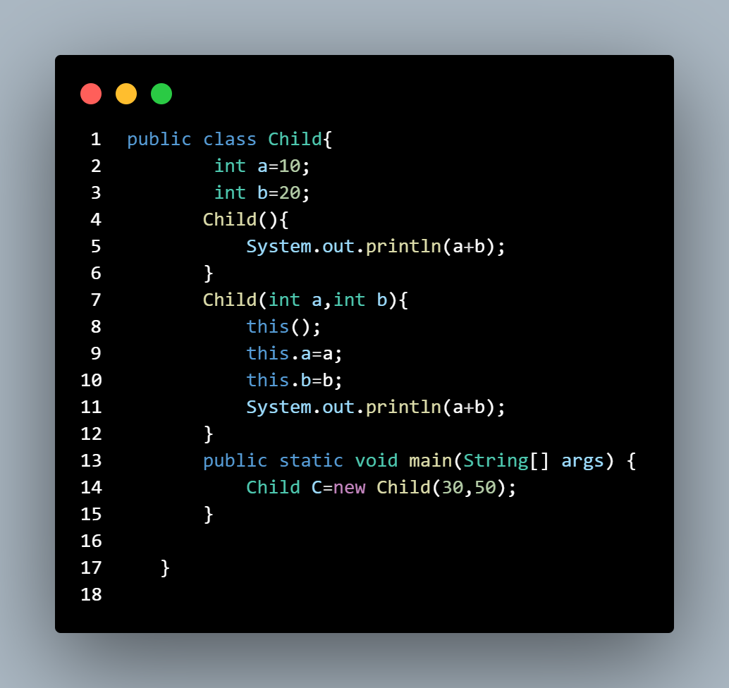
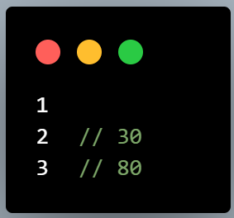
Hiveed.java
Example :
JAVA Programming

Slide 14
Hiveed.java
Super Keyword:
‘super’ is a reference variable that refers to the parent object, or can be said “Super” in Java is a keyword that refers to the parent class object instance of parent class.
When the child aand parent class have same variable name in order to differtiate we use “super” keyword.
is a relationship is manditory.
Syntax :
super.a=a
JAVA Programming

Slide 15
Hiveed.java
Super Call:
Super call statement is used to call the Parent class constructor.
Complier will defaut add super call statement in the child class Constructor.
Is a relatinship is manditory.
Syntax :
super( );
JAVA Programming

Slide 16
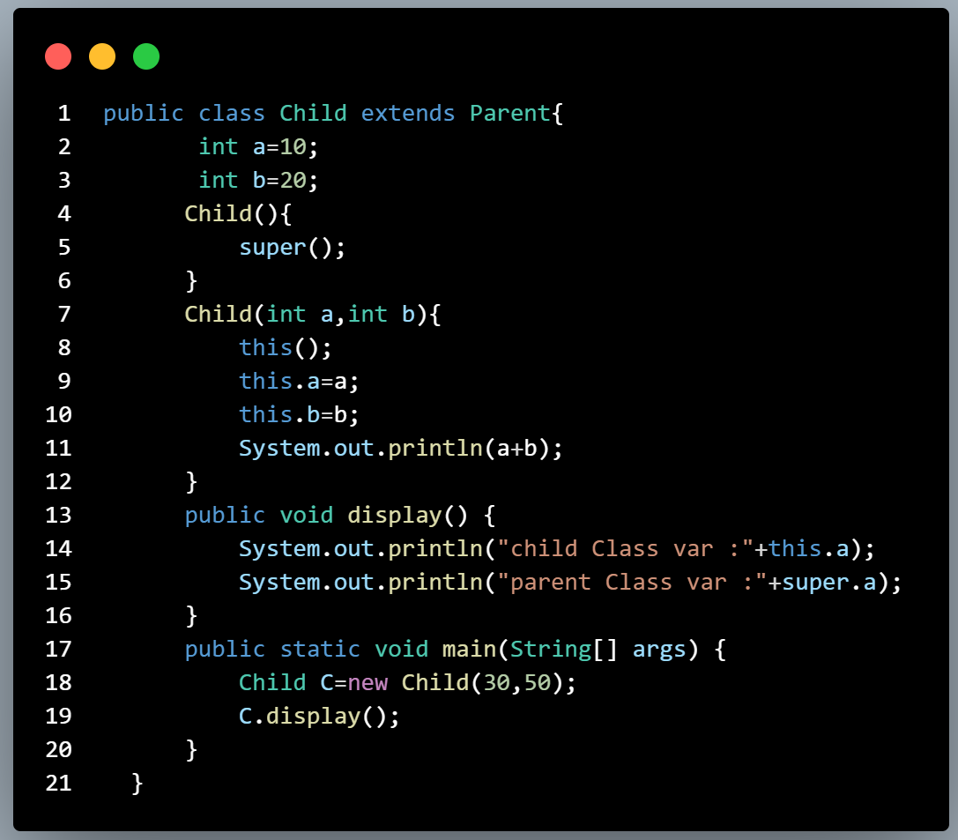
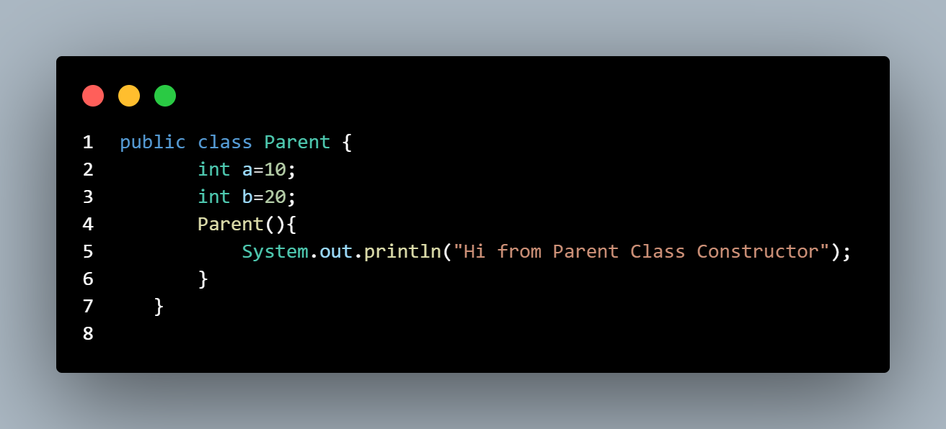
Hiveed.java
Example :
JAVA Programming

Slide 17
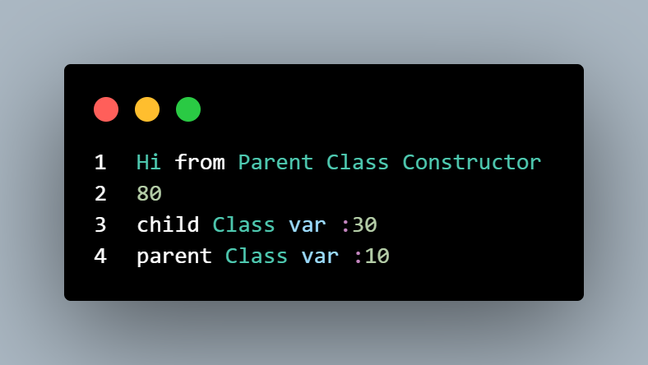
Hiveed.java
Output :
JAVA Programming

